Slide 1

Welcome
to
Introductory Session of Reverse Engineering & Binary Exploitation

Slide 2

Hello, I am Arib Zobair
Who am I
A cybersecurity enthusiast and active CTF player, currently a sub-executive member of the EWUCSC, working on reverse engineering, binary exploitation, malware analysis, and game patching/modding.

Slide 3
Table of contents
01
02
03
04
05
06
Introduction to Reverse Engineering
How programs become executables
CPU & Memory Basics
What is reverse engineering ?
Why is it needed?
Compilation process of a program
Executable formats
Program Memory Layout
Stack Frame & Function Calls
Introduction to Assembly Language
Walkthrough to
Rev Challenges
Static & Dynamic Analysis
Buffer Overflow
Binary Protection/checksec
Ret2win Challenge
What is Assembly Language?
Common Instructions
X86-64 Calling Convention
What is Static & Dynamic Analysis?
Tools to use

Slide 4
Table of contents
07
Conclusion
Ending Remarks

Slide 5
Introduction to Reverse Engineering
01

Slide 6
Introduction to Reverse Engineering
What is Reverse Engineering?
Reverse engineering (RE) is the process of analyzing a compiled program to understand its core functionality.
How the code works
How it was built
And how to modify it
In software reverse engineering, we analyze compiled programs (executables/binaries) without having access to the original source code.

Slide 7
Introduction to Reverse Engineering
Why is it needed?
Reverse engineering is needed for various purposes some of them are:
Vulnerability Research
Malware analysis
Digital Forensics
Legacy Software Debugging
Game Hacking/Modding
CTF competitions

Slide 8
02
How do programs become executables

Slide 9
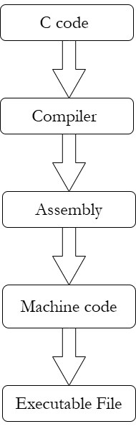
How does programs become executables
Let’s see the compilation process of program
CPU only understands machine code
Assembly is human-readable machine
instructions
Reverse engineers analyze
assembly/decompiled code

Slide 10
How does programs become executables
Executable Formats
For windows:
supportable formats are PE ( Portable Execution )
For Linux:
supportable formats are ELF ( Executable & Linkable Format)
Executables basically contains code, metadata, imported libraries, functions, strings etc.

Slide 11
CPU & Memory Basics
03

Slide 12
CPU & Memory Basics
Program Memory Layout
How Does a Program Use Memory?
When a program is running, different parts of memory serve different purposes.
When we execute a binary, the operating system creates a process and maps the program into memory. Different regions have different purposes.

Slide 13
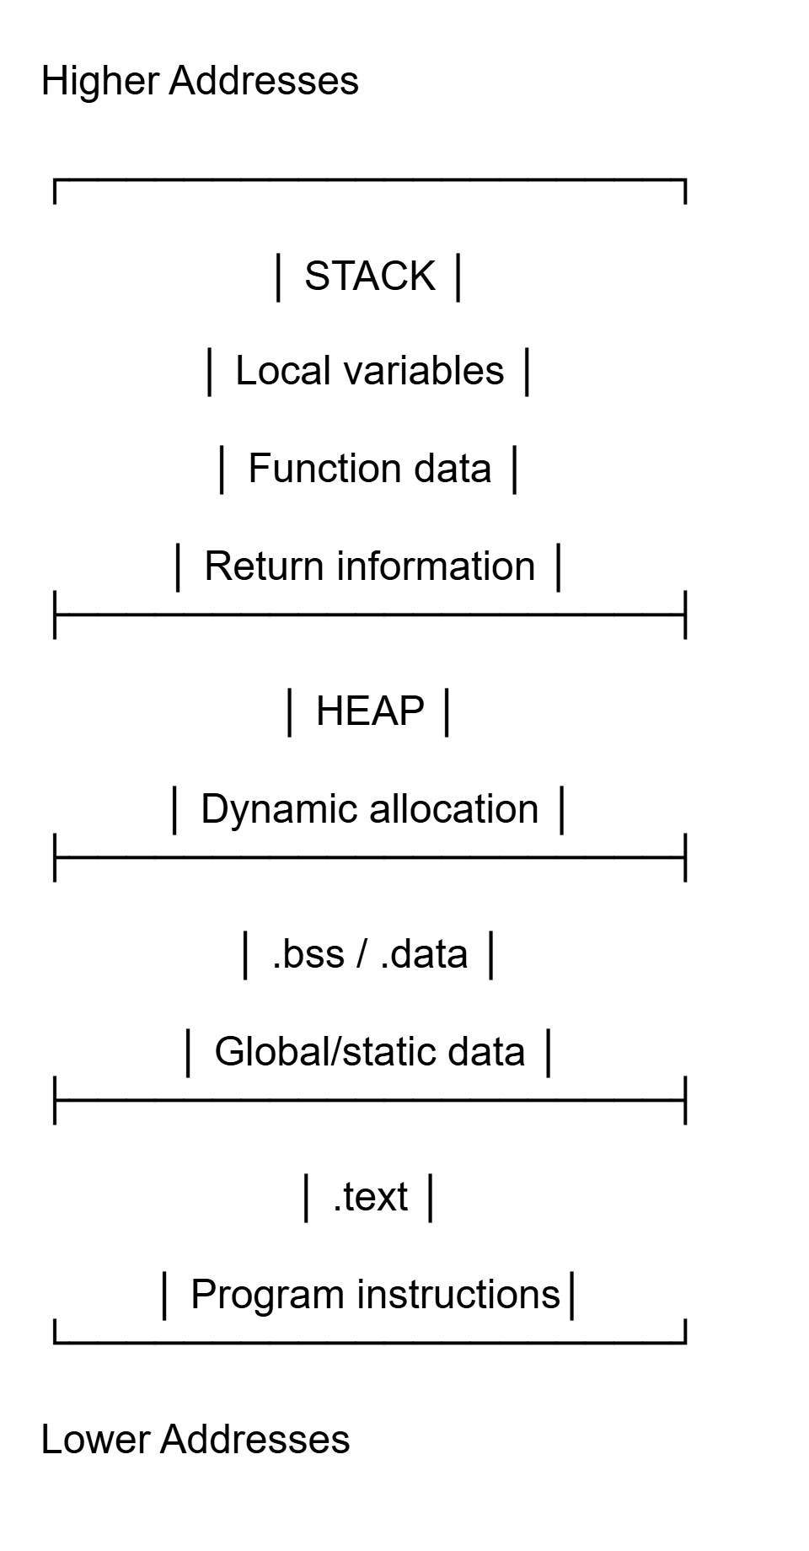
CPU & Memory Basics

Slide 14
CPU & Memory Basics
.text
Contains executable machine instructions.
.data
Initialized global and static variables.
.bss
Uninitialized or zero-initialized global/static variables. Variables with initial value 0.
Heap
Memory used for dynamic allocation such as malloc().
Stack
Memory used during function execution, including local variables and information needed for function calls.

Slide 15
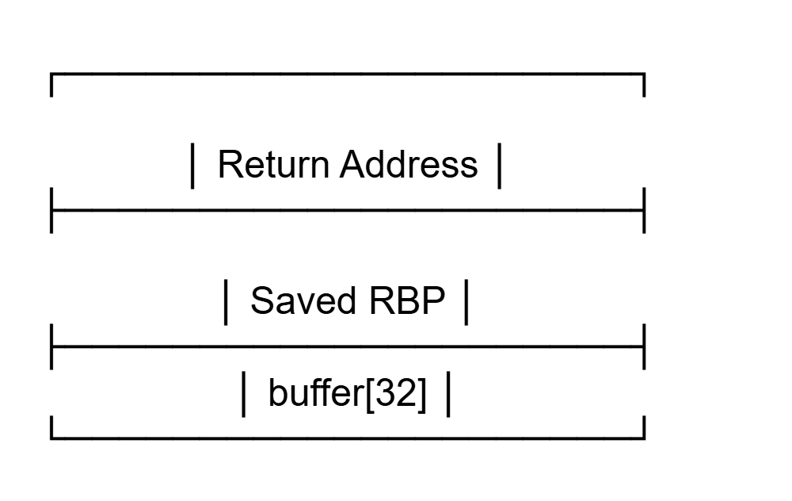
CPU & Memory Basics
Stack Frame & Function Calls
A stack frame is the portion of the stack associated with a particular function call.
A simplified stack frame:
Local variables → such as buffer
Saved RBP → previous frame-pointer information, when a frame pointer is used
Return address → where execution should continue after the function returns
A stack frame is the portion of the stack associated with a particular function call.

Slide 16
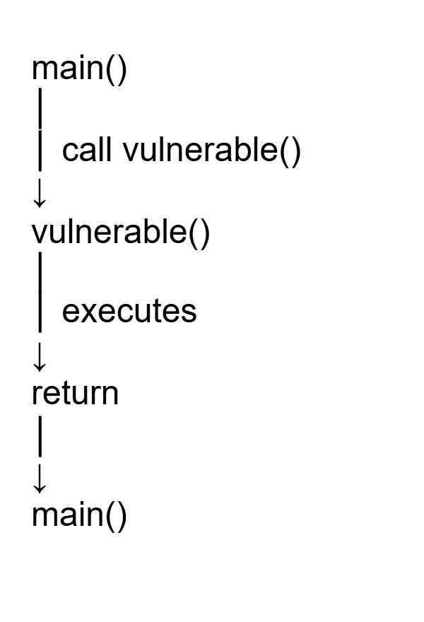
CPU & Memory Basics
Stack Frame & Function Calls
Conceptually what happens is:
Suppose
int main()
{
vulnerable();
}
When main() calls vulnerable(), the CPU needs information that allows vulnerable() to eventually return to the appropriate place in main()

Slide 17
CPU & Memory Basics
Some CPU Registers
Registers are tiny memory locations. They are very fast and are inside the CPU.
Some of the important CPU registers are:
Registers | Purpose
RAX | return values/calculations
RSP | stack pointer
RBP | Often used as frame pointer
RIP | Current instruction pointer

Slide 18
04
Introduction to Assembly Language

Slide 19
Introduction to Assembly Language
What is Assembly Language
Assembly language is a low-level programming language that closely represents machine code instructions executed by the CPU.
It provides a human-readable form of binary instructions.
Each assembly instruction usually corresponds to a single CPU operation.
Reverse engineers analyze assembly to understand how programs behave internally.

Slide 20
Introduction to Assembly Language
Common Instructions
Instruction | Meaning
MOV | copy data
ADD | addition
SUB | subtraction
CMP | compare
JMP | unconditional jump
JE/JZ | jump if equal
JNE/JNZ | jump if not equal
CALL | call function
RET | return
Instruction | Use case
eax | Used for math, data and function return values
ebx | Base address
ecx | Used as counter for loops
edx | Used for math, data

Slide 21
Introduction to Assembly Language
Examples
( Conditional logic in Assembly)
if(x == 5){ success(); }
This condition will be interpreted in the assembly as the following:
cmp eax, 5 je success

Slide 22
Introduction to Assembly Language
How are function arguments are passed?
Suppose, we have
int add(int a, int b)
{
return a + b;
}
The CPU doesn’t understand a & b as C variables.
The calling convention establishes where the arguments are placed before the function executes.

Slide 23
Introduction to Assembly Language
Conceptually, what happens is
RDI = a
RSI = b
↓
add()
↓
RAX = result
So, if we see
This essentially means,
mov edi, 10
mov esi, 20
call add
add(10, 20);
Try to remember,
RDI, RSI, RDX, RCX, R8, R9 → first six integer/pointer arguments. RAX → return value.

Slide 24
05
Static and Dynamic Analysis

Slide 25
Static & Dynamic Analysis
Static Analysis
Static analysis is basically analyzing a program WITHOUT running it.
Our main goals in static analysis are to
identify functions
inspect strings
understand logic
locate checks/passwords

Slide 26
Static & Dynamic Analysis
Dynamic Analysis
Dynamic analysis is basically analyzing a program While it runs.
Our main goals in dynamic analysis are to
observe behavior
inspect memory
trace executions
bypass protections
We frequently use breakpoints in dynamic analysis.

Slide 27
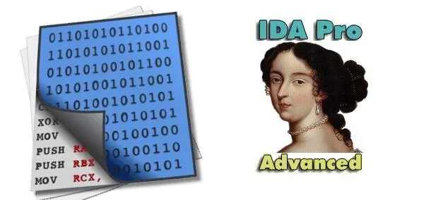
Static & Dynamic Analysis
Tools to use
IDA Pro
Industry-standard interactive disassembler and reverse engineering tool.
Converts machine code into readable assembly and pseudocode.
Supports advanced binary analysis, debugging, and plugin extensions.
Commonly used by professional malware analysts and security researchers.
Known for its powerful analysis engine and decompiler capabilities.

Slide 28
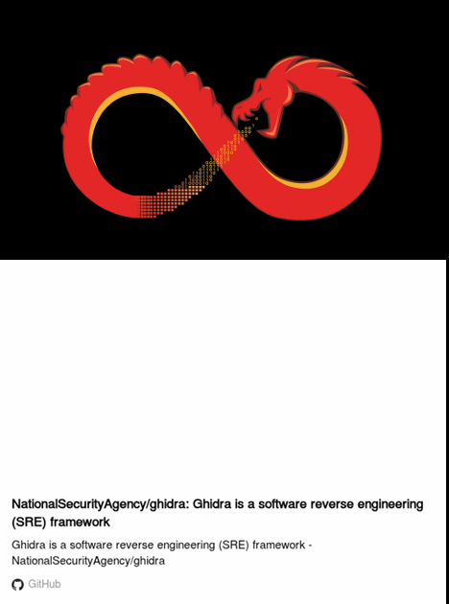
Static & Dynamic Analysis
Tools to use
Ghidra
Open-source reverse engineering framework developed by the NSA.
Provides powerful disassembly and decompilation features for multiple architectures.
Supports function analysis, cross-references, scripting, and control flow visualization.
Widely used in malware analysis, CTFs, and binary reversing.
Considered one of the best free alternatives to IDA Pro.

Slide 29
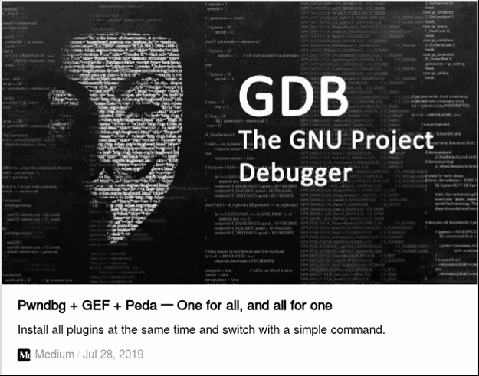
Static & Dynamic Analysis
Tools to use
GDB
Powerful debugger used mainly on Linux systems.
Allows runtime debugging, breakpoint analysis, and memory inspection.
Supports step-by-step execution and stack/register visualization.
Widely used in reverse engineering, exploit development, and systems debugging.
Often enhanced with extensions such as pwndbg, GEF, or PEDA.

Slide 30

Static & Dynamic Analysis
Tools to use
BinaryNinja
Modern reverse engineering platform with interactive disassembly and decompilation.
Known for its clean interface and strong control flow analysis features.
Supports binary patching, scripting, and plugin development.
Useful for malware analysis, vulnerability research, and CTF reversing.
Community Edition is available with limited functionality.

Slide 31

Static & Dynamic Analysis
Tools to use
x64dbg
Free Windows debugger designed for reverse engineering and binary analysis.
Supports breakpoints, step-by-step execution, memory inspection, and patching.
Beginner-friendly graphical interface for dynamic analysis.
Frequently used in crackme solving and malware debugging.
Useful for observing runtime behavior of executables.

Slide 32
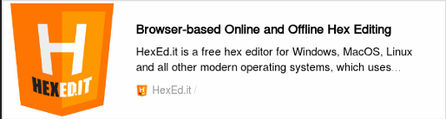
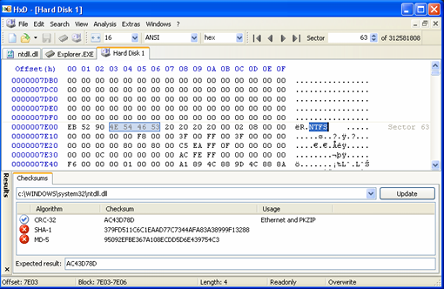
Static & Dynamic Analysis
Tools to use
HxD (Hex editors)
Tools used to inspect and edit raw binary data at byte level.
Allow direct modification of executable files without recompilation.
Useful for patching binaries, changing instructions, or inspecting file structures.
Commonly used in binary analysis and forensic investigations.

Slide 33
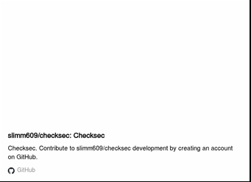
Static & Dynamic Analysis
Tools to use
Checksec
Command-line utility for inspecting binary security protections.
Shows NX, PIE, RELRO, and stack canary status
Helps identify potential exploitation vectors

Slide 34
Walkthrough to Rev Challenges

Slide 35
Walkthrough to Rev Challenges
What is a Buffer ?
A buffer is a fixed-size region of memory used to store data.
char buffer[32];
Each character has 1 bytes. So,
char buffer[32]
↓
32 bytes of storage
Q: What happens if the program tries to put 100 bytes into this 32-byte buffer?

Slide 36
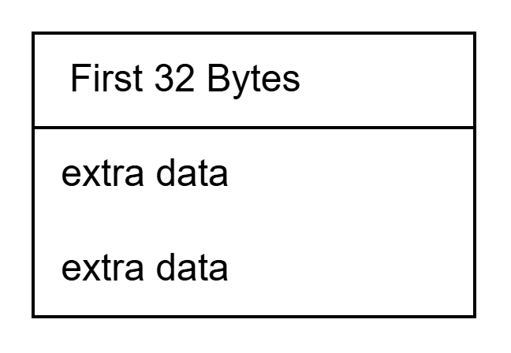
Walkthrough to Rev Challenges
Buffer Overflow
A buffer overflow occurs when a program writes more data into a buffer than the space allocated for it.
Buffer size = 32 bytes
Input = 100 bytes

Slide 37
Walkthrough to Rev Challenges
Buffer Overflow
Q. Has the extra data vanished?
No. The extra data doesn't magically disappear. If bounds aren't checked, the write can continue into adjacent memory.
buffer
↓
saved data
↓
return address

Slide 38
Walkthrough to Rev Challenges
Return Address
Q. What is Return Address ?
The return address tells the program where execution should continue after a function returns.
main()
│
call vulnerable()
↓
vulnerable()
│
ret
↓
main()

Slide 39
Walkthrough to Rev Challenges
Return Address
When vulnerable() finishes, the CPU needs to know where to continue. That information is associated with the saved return address.
If a memory corruption bug allows us to overwrite that value, we may be able to influence the program's control flow.

Slide 40
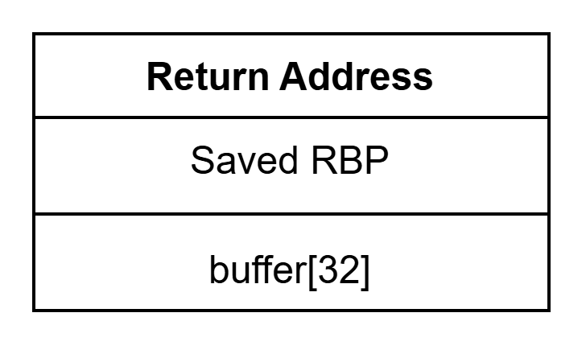
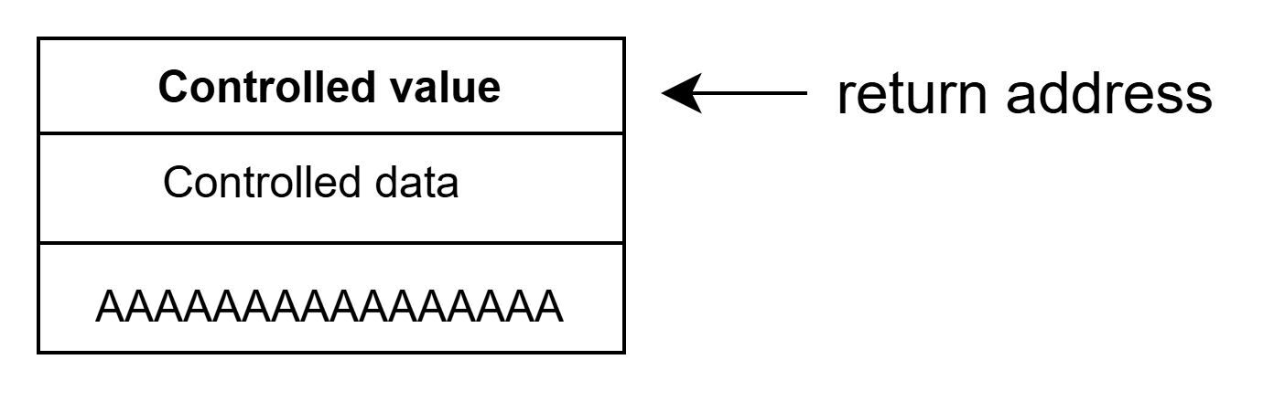
Walkthrough to Rev Challenges
From Overflow to Control Flow
Normal Stack
After excessive input:

Slide 41
Walkthrough to Rev Challenges
From Overflow to Control Flow
So, the total workflow stands
Buffer Overflow
↓
Stack corruption
↓
Return address overwritten
↓
Control-flow influence
A sufficiently powerful buffer overflow may allow us to overwrite the saved return address and influence control flow.

Slide 42
Walkthrough to Rev Challenges
ret2win
Suppose, the binary contains
void win()
{
printf("You win!");
}
and
void vulnerable()
{
char buffer[32];
// vulnerable input
}

Slide 43
Walkthrough to Rev Challenges
ret2win
After the exploit:
How it supposed to work:
vulnerable()
↓
return
↓
caller
vulnerable()
↓
return
↓
win()
↓
FLAG

Slide 44
Walkthrough to Rev Challenges
ret2win
Instead of injecting new code, we redirect execution to a function that already exists in the binary.
This is why ret2win is a good beginner exercise.

Slide 45

Walkthrough to Rev Challenges
Finding the Offset
Supposed simplified stack
Distance from buffer to return address:
32 + 8 = 40 bytes
Conceptually,
[ 40 bytes padding ][ address of win ]

Slide 46
Walkthrough to Rev Challenges
Finding the Offset
The offset is how many bytes we need to send before reaching the value we want to overwrite.
#Important to Remember
Here, 40 is only just an example. The actual offset must be determined from the specific binary.

Slide 47
Walkthrough to Rev Challenges
Basic Binary Exploitation Workflow
Binary
↓
file / checksec
↓
Static Analysis
Ghidra
↓
Find interesting
functions
↓
Identify bug
↓
Understand stack
↓
Find target
win()
↓
Find offset
↓
Test in GDB
↓
FLAG

Slide 48
Walkthrough to Rev Challenges
Basic Binary Exploitation Workflow
The workflow is not a magical sequence that solves every pwn challenge.
It’s just a basic workflow that helps us organize our thinking

Slide 49
Let’s solve some challenges
You can enter a subtitle here if you need it

Slide 50
Thanks!
Do you have any questions?

